Slide 1
LAN Connections
Routing

Slide 2
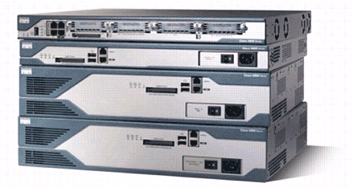
Routers
Cisco 2800 Series Router
Routers have the following components:
CPU
Motherboard
RAM
ROM
Routers have network adapters to which IP addresses are assigned.
Routers may have the following two kinds of ports:
Console: For the attachment of a terminal used for management
Network: Different LAN or WAN media ports
Routers forward packets based upon a routing table.

Slide 3
Router Functions
RouterX# show ip route
D 192.168.1.0/24 [90/25789217] via 10.1.1.1
R 192.168.2.0/24 [120/4] via 10.1.1.2
O 192.168.3.0/24 [110/229840] via 10.1.1.3
1
2
Lets other routers know about changes
Determines where to forward packets

Slide 4
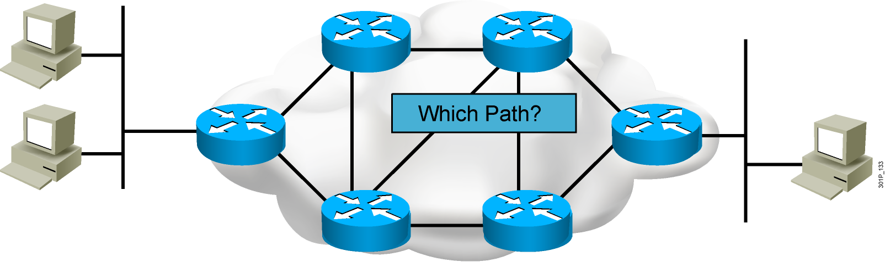
Path Determination

Slide 5
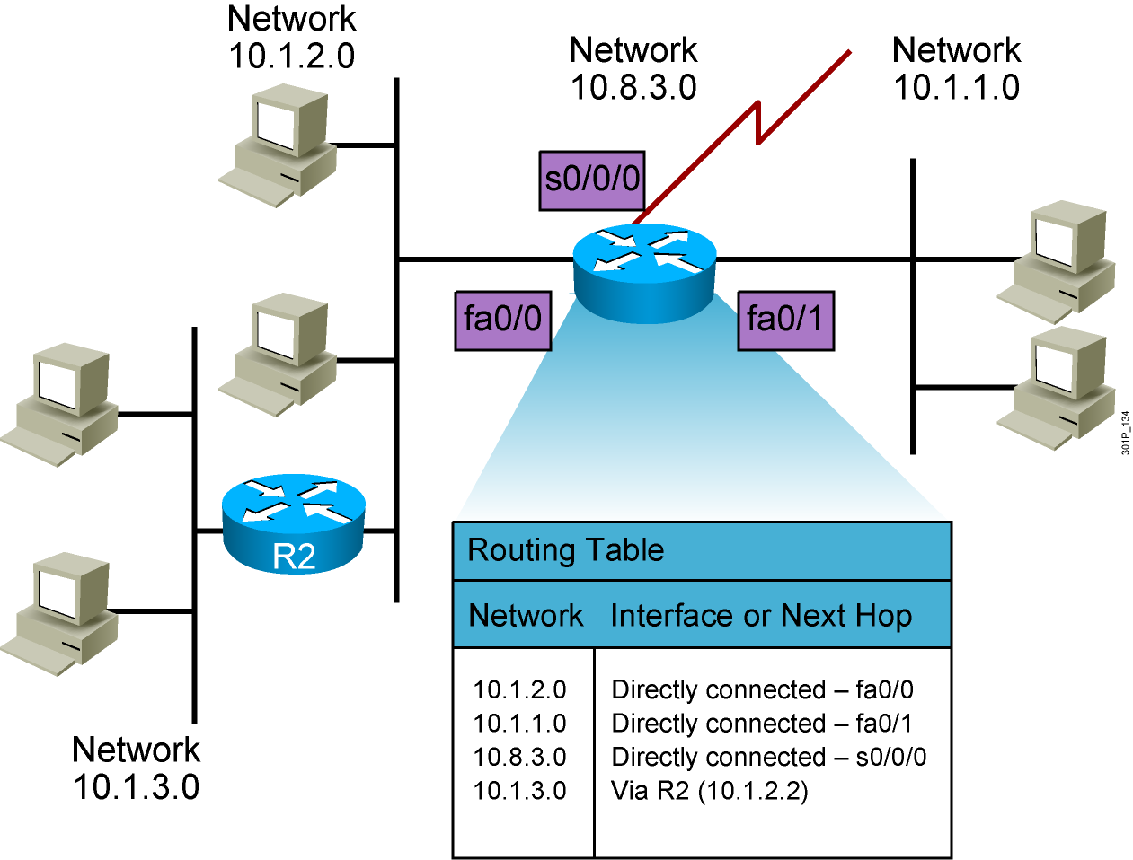
Routing Tables

Slide 6
Routing Table Entries
Directly connected: Router attaches to this network
Static routing: Entered manually by a system administrator
Dynamic routing: Learned by exchange of routing information
Default route: Statically or dynamically learned; used when no explicit route to network is known

Slide 7
Static vs. Dynamic Routes
Static Route
Uses a route that a network administrator enters into the router manually
Dynamic Route
Uses a route that a network routing protocol adjusts automatically for topology or traffic changes
Notes:
Purpose: This figure introduces students to static and dynamic routes.
Emphasize: Static knowledge is administered manually—a network administrator enters it into the router’s configuration. The administrator must manually update this static route entry whenever an internetwork topology change requires an update. Static knowledge can be private—by default it is not conveyed to other routers as part of an update process. You can, however, configure the router to share this knowledge.
Dynamic knowledge works differently. After the network administrator enters configuration commands to start dynamic routing, route knowledge is updated automatically by a routing process. Whenever new topology information is received from the internetwork, routers update neighbors about the route change.

Slide 8
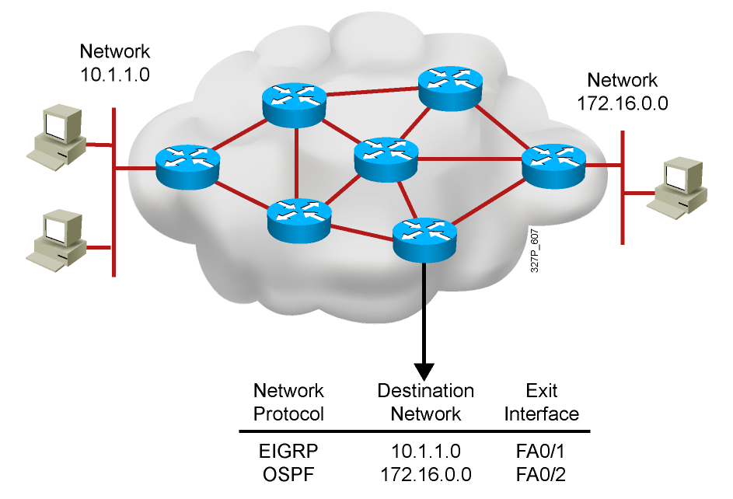
What Is a Dynamic Routing Protocol?
Routing protocols are used between routers to determine paths to remote networks and maintain those networks in the routing tables.
After the path is determined, a router can route a routed protocol to the learned networks.
Notes:
Purpose: This figure introduces students to routing protocols and compares routing protocols to routed protocols.
Emphasize: If network 10.120.2.0 wants to know about network 172.16.2.0, it must learn it from its S0 (or possibly S1) interface.
Note: The two routing protocols that will be taught in this course are RIP and IGRP. They are both distance vector routing protocols.

Slide 9
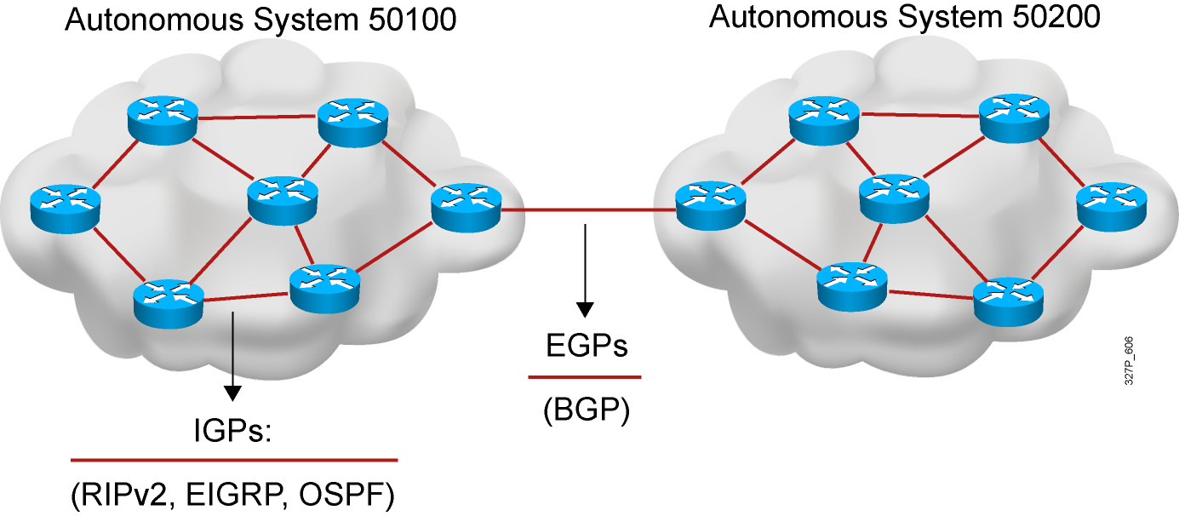
Autonomous Systems: Interior and Exterior Routing Protocols
An autonomous system is a collection of networks within a common administrative domain.
Interior gateway protocols operate within an autonomous system.
Exterior gateway protocols connect different autonomous systems.
Notes:
Purpose: This figure discusses autonomous systems, IGPs and EGPs.
Emphasize: Introduce the interior/exterior distinctions for routing protocols, as follows:
Interior routing protocols are used within a single autonomous system
Exterior routing protocols are used to communicate between autonomous systems
The design criteria for an interior routing protocol require it to find the best path through the network. In other words, the metric and how that metric is used is the most important element in an interior routing protocol.
Exterior protocols are used to exchange routing information between networks that do not share a common administration. IP exterior gateway protocols require the following three sets of information before routing can begin:
A list of neighbor (or peer) routers or access servers with which to exchange routing information
A list of networks to advertise as directly reachable
The autonomous system number of the local router

Slide 10
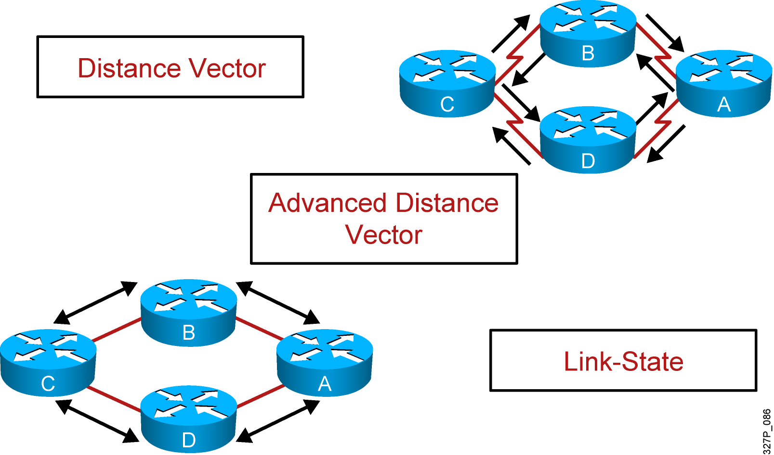
Classes of Routing Protocols
Notes:
Purpose: This figure introduces the three classes of routing protocols.
Emphasize: There is no single best routing protocol.
Note: Distance vector routing protocol operation is covered in detail later in this course. Link state and hybrid are only briefly explained after the distance vector discussion. Refer students to the ACRC to learn more about link-state and hybrid routing protocols.

Slide 11
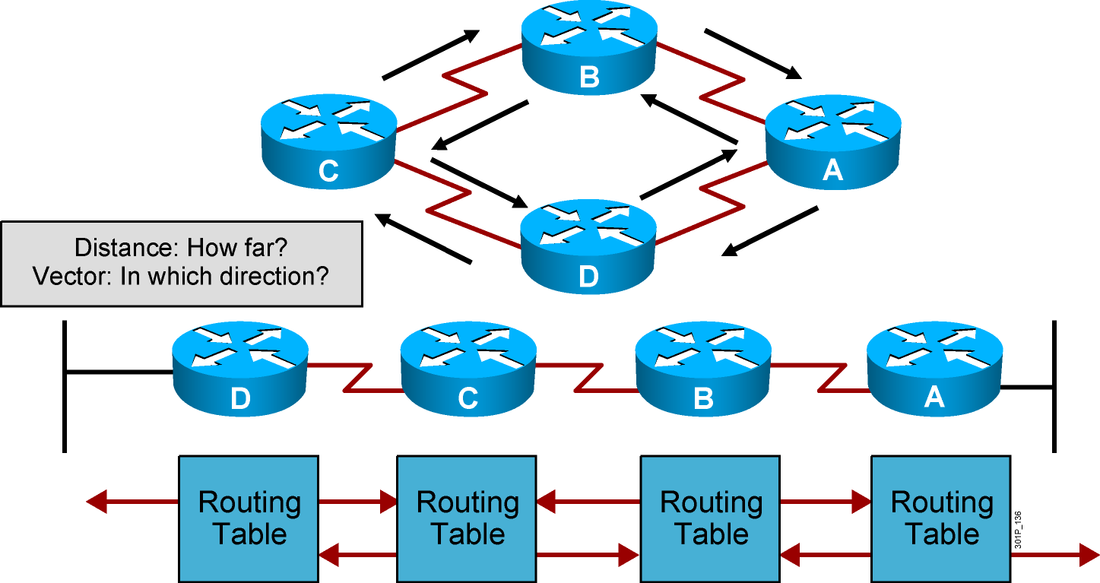
Distance Vector Routing Protocols
Passes periodic copies of routing table to neighbor routes and accumulates distance vectors
Notes:
Lesson Aim
<Enter lesson aim here.>

Slide 12
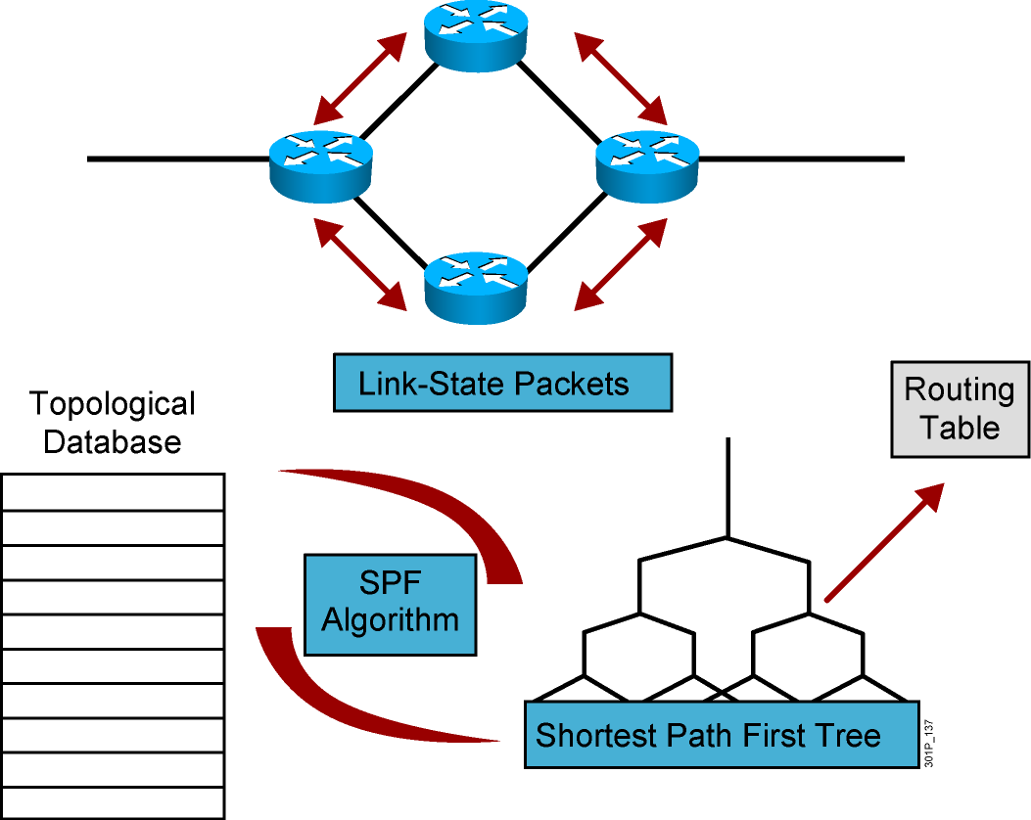
Link-State Routing Protocols
After initial flood, passes small event-triggered link-state updates to all other routers
Notes:
Lesson Aim
<Enter lesson aim here.>

Slide 13
Classful Routing Protocol
Classful routing protocols do not include the subnet mask with the route advertisement.
Within the same network, consistency of the subnet masks is assumed.
Summary routes are exchanged between foreign networks.
These are examples of classful routing protocols:
RIPv1
IGRP

Slide 14
Classless Routing Protocol
Classless routing protocols include the subnet mask with the route advertisement.
Classless routing protocols support a variable-length subnet mask (VLSM).
Summary routes can be manually controlled within the network.
These are examples of classless routing protocols:
RIPv2
EIGRP
OSPF
IS-IS

Slide 15
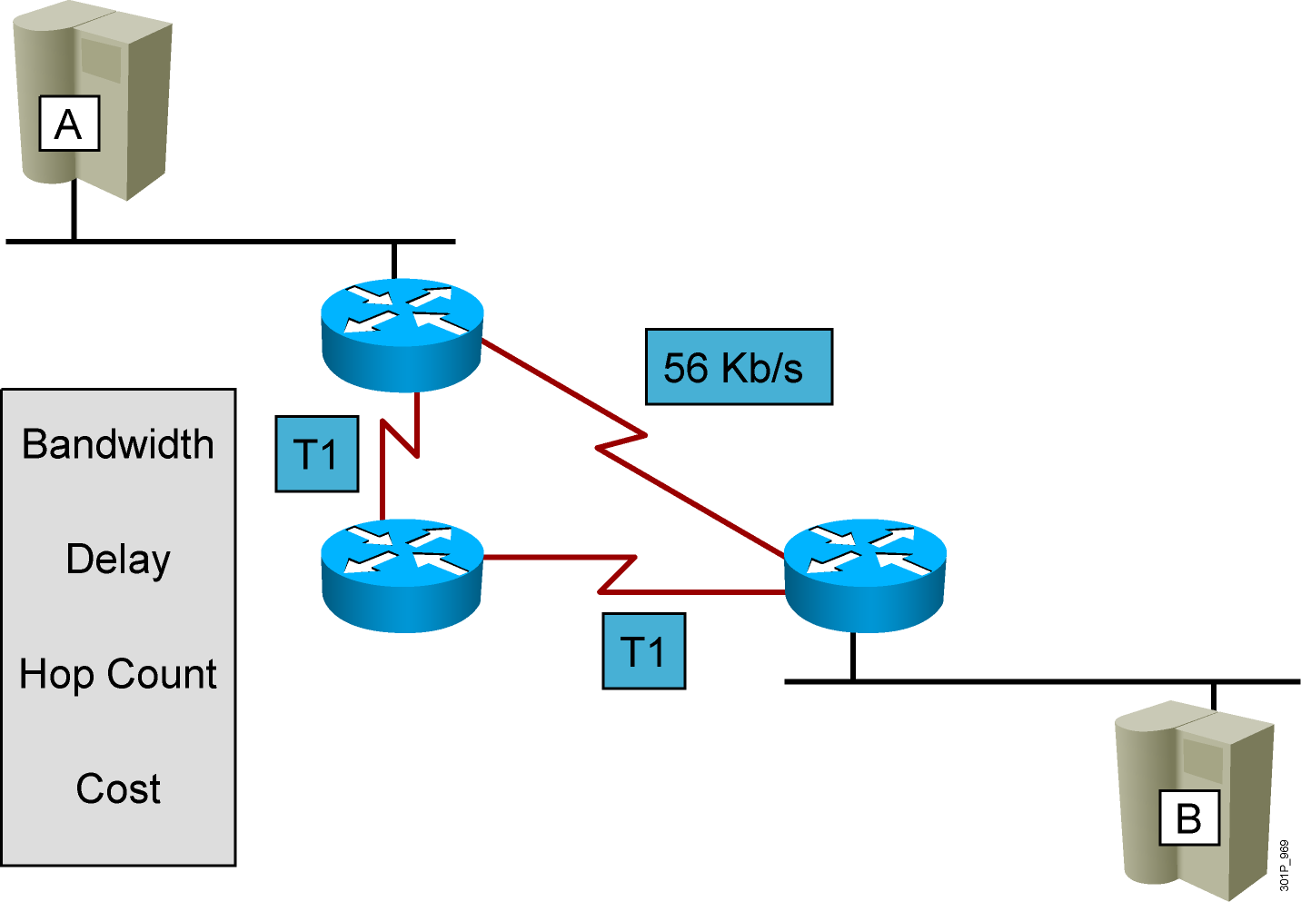
Routing Metrics
If a router learns of more than one route to reach one subnet, choose the best route based on that routing protocol’s concept of a metric

Slide 16
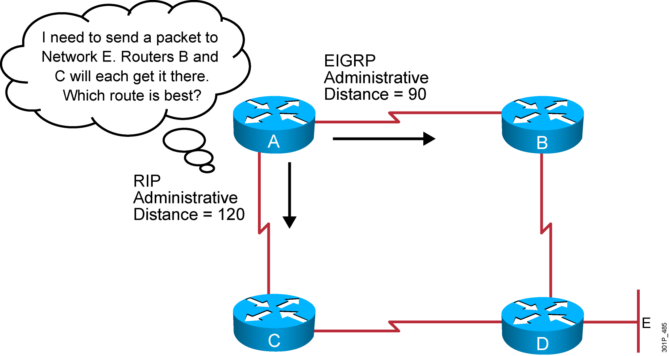
Administrative Distance: Ranking Routes
If a router learns routes for the listed subnet from more than one source of routing information, the router uses the source with the lowest administrative distance (AD)
Notes:
5
Purpose: This figure introduces administrative distance.
Emphasize: An administrative distance is a rating of the trustworthiness of a routing information source, such as an individual router or a group of routers. In a large network, some routing protocols and some routers can be more reliable than others as sources of routing information.
The default administrative distance for static routes and various routing protocols is listed in the Student Guide. The lower the distance, the more trustworthy the route is. For example, in the figure, the packet would learn the route learned via IGRP.

Slide 17
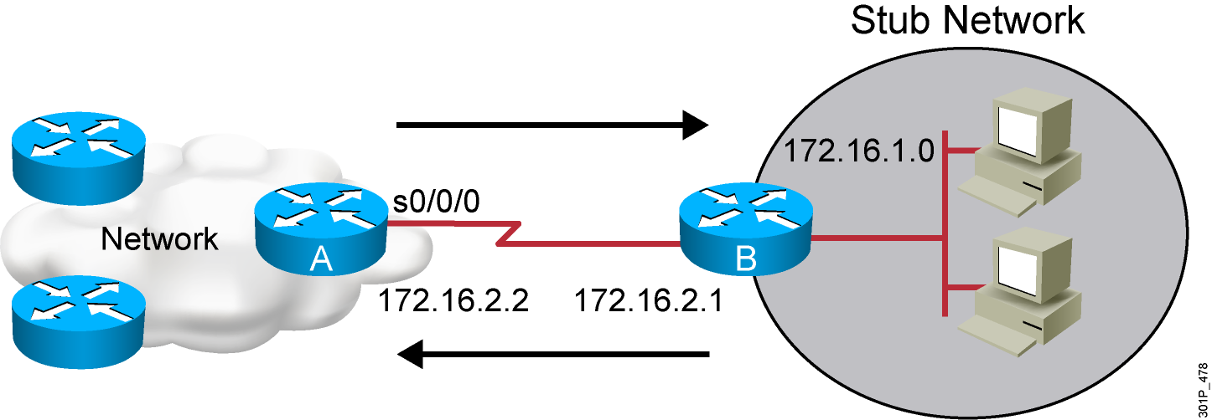
Static Routes
Configure unidirectional static routes to and from a stub network to allow communications to occur.
Notes:
Purpose: This figure describes how a static route operates.
Emphasize: For intercommunication, static routes must be configured in both directions. Static routes are often used to route traffic to a stub network or other network where only a single route to that network exists.

Slide 18
Static Route Configuration
RouterX(config)# ip route network [mask] {address | interface}[distance] [permanent]
Defines a path to an IP destination network or subnet or host
Address = IP address of the next hop router
Interface = outbound interface of the local router
Notes:
Purpose: This figure describes the command syntax used to establish an IP static route.
Emphasize: A static route allows manual configuration of the routing table. No dynamic changes to this table entry will occur as long as the path is active. Routing updates are not sent on a link that is only defined by a static route; hence, conserving bandwidth.
The ip route field descriptions are as follows:
network—Destination network or subnet
mask—Subnet mask
address—IP address of next-hop router
interface—Name of the interface to use to get to the destination network
Transition: The next figure provides a static route configuration example.

Slide 19
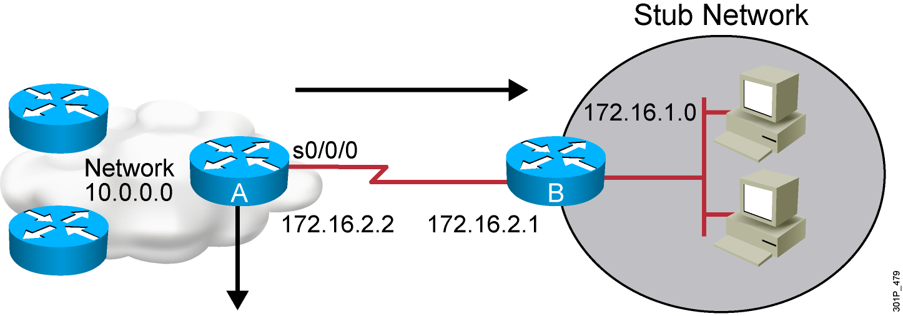
Static Route Example
RouterX(config)# ip route 172.16.1.0 255.255.255.0 172.16.2.1
or
Router(config)#ip route 172.16.1.0 255.255.255.0 s0/0/0
This is a unidirectional route. You must have a route configured in the opposite direction.
Notes:
Purpose: This figure gives an example of a static route configuration.

Slide 20
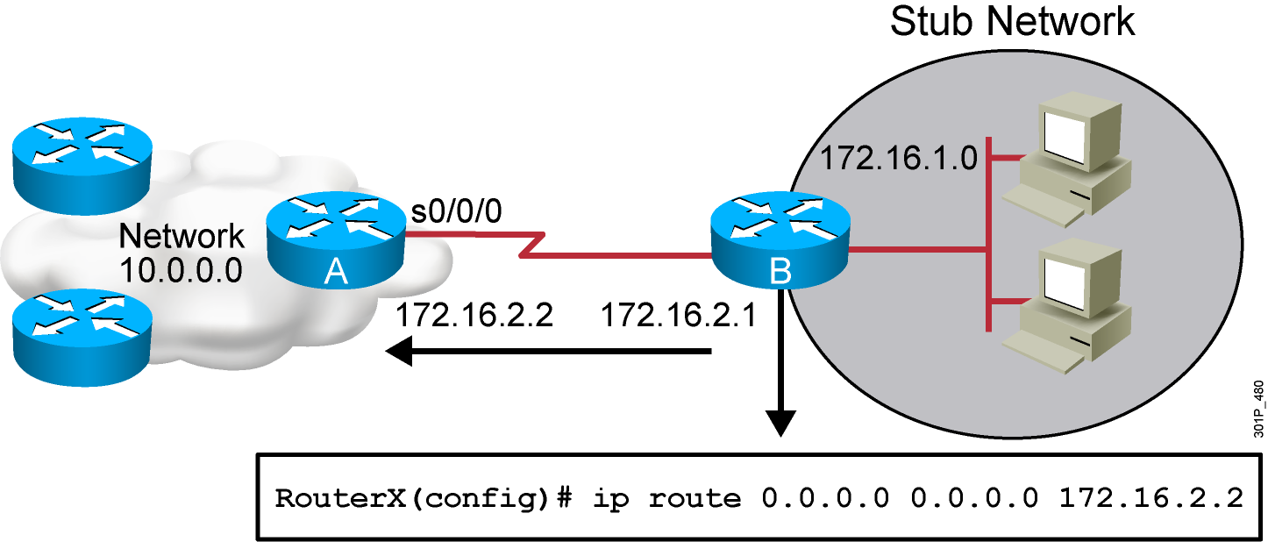
Default Routes
This route allows the stub network to reach all known networks beyond Router A.
Notes:
Purpose: This figure gives an example of a default route configuration.
Emphasize: With an address and subnet mask of 0.0.0.0 0.0.0.0 in the ip route statement, packets for any network not listed in the routing table will be sent to the next hop, 172.16.2.2.

Slide 21
Verifying the Static Route Configuration
RouterX# show ip route
Codes: C - connected, S - static, I - IGRP, R - RIP, M - mobile, B - BGP
D - EIGRP, EX - EIGRP external, O - OSPF, IA - OSPF inter area
E1 - OSPF external type 1, E2 - OSPF external type 2, E - EGP
i - IS-IS, L1 - IS-IS level-1, L2 - IS-IS level-2, * - candidate default
U - per-user static route
Gateway of last resort is 0.0.0.0 to network 0.0.0.0
10.0.0.0/8 is subnetted, 1 subnets
C 10.1.1.0 is directly connected, Serial0/0/0
S* 0.0.0.0/0 is directly connected, Serial0
Notes:
Slide 2 of 6
Purpose: This figure shows how the show frame-relay LMI command is used to verify the LMI type used for signaling.
Emphasize: Describe the highlighted output to the students.

Slide 22
WAN Connections
Enabling RIP

Slide 23
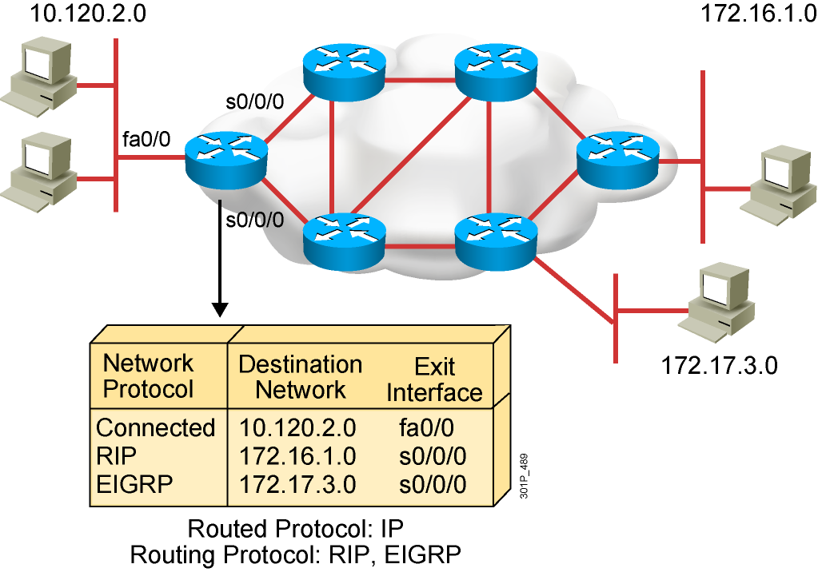
What Is a Routing Protocol?
Routing protocols are used between routers to determine paths and maintain routing tables.
After the path is determined, a router can route a routed protocol.
Notes:
Purpose: This figure introduces students to routing protocols and compares routing protocols to routed protocols.
Emphasize: If network 10.120.2.0 wants to know about network 172.16.2.0, it must learn it from its S0 (or possibly S1) interface.
Note: The two routing protocols that will be taught in this course are RIP and IGRP. They are both distance vector routing protocols.

Slide 24
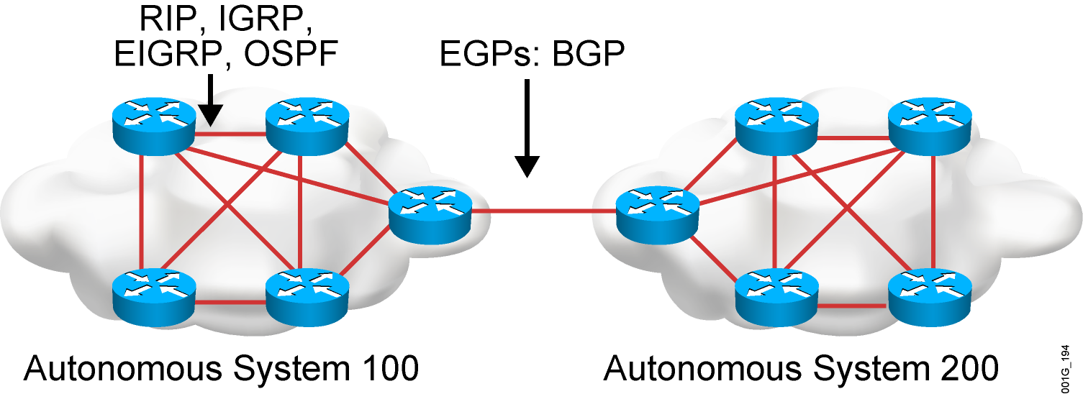
Autonomous Systems: Interior or Exterior Routing Protocols
An autonomous system is a collection of networks under a common administrative domain.
IGPs operate within an autonomous system.
EGPs connect different autonomous systems.
Notes:
Purpose: This figure discusses autonomous systems, IGPs and EGPs.
Emphasize: Introduce the interior/exterior distinctions for routing protocols, as follows:
Interior routing protocols are used within a single autonomous system
Exterior routing protocols are used to communicate between autonomous systems
The design criteria for an interior routing protocol require it to find the best path through the network. In other words, the metric and how that metric is used is the most important element in an interior routing protocol.
Exterior protocols are used to exchange routing information between networks that do not share a common administration. IP exterior gateway protocols require the following three sets of information before routing can begin:
A list of neighbor (or peer) routers or access servers with which to exchange routing information
A list of networks to advertise as directly reachable
The autonomous system number of the local router

Slide 25
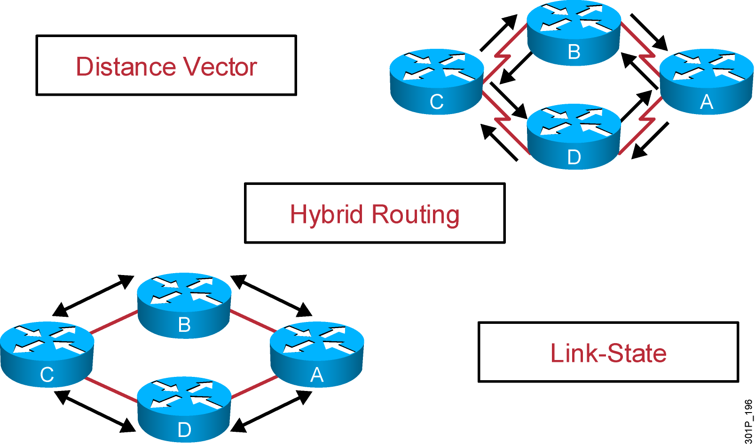
Classes of Routing Protocols
Notes:
Purpose: This figure introduces the three classes of routing protocols.
Emphasize: There is no single best routing protocol.
Note: Distance vector routing protocol operation is covered in detail later in this course. Link state and hybrid are only briefly explained after the distance vector discussion. Refer students to the ACRC to learn more about link-state and hybrid routing protocols.

Slide 26
Administrative Distance: Ranking Routes
Notes:
5
Purpose: This figure introduces administrative distance.
Emphasize: An administrative distance is a rating of the trustworthiness of a routing information source, such as an individual router or a group of routers. In a large network, some routing protocols and some routers can be more reliable than others as sources of routing information.
The default administrative distance for static routes and various routing protocols is listed in the Student Guide. The lower the distance, the more trustworthy the route is. For example, in the figure, the packet would learn the route learned via IGRP.

Slide 27
Classful Routing Protocol
Classful routing protocols do not include the subnet mask with the route advertisement.
Within the same network, consistency of the subnet masks is assumed.
Summary routes are exchanged between foreign networks.
These are examples of classful routing protocols:
RIPv1
IGRP

Slide 28
Classless Routing Protocol
Classless routing protocols include the subnet mask with the route advertisement.
Classless routing protocols support a variable-length subnet mask (VLSM).
Summary routes can be manually controlled within the network.
These are examples of classless routing protocols:
RIPv2
EIGRP
OSPF
IS-IS

Slide 29
Distance Vector Routing Protocols
Routers pass periodic copies of their routing table to neighboring routers and accumulate distance vectors
Notes:
Purpose: This figure introduces the distance vector routing algorithm, the first of the classes of routing protocols, and outlines how it operates.
Emphasize: Distance vector algorithms do not allow a router to know the exact topology of an internetwork.
This information is somewhat analogous to the information found on signs at a highway intersection. A sign points toward a road leading away from the intersection and indicates the distance to the destination.
Further down the highway, another sign also points toward the destination, but now the distance to the destination is shorter.
As long as each successive point on the path shows that the distance to the destination is successively shorter, the traffic is following the best path.

Slide 30
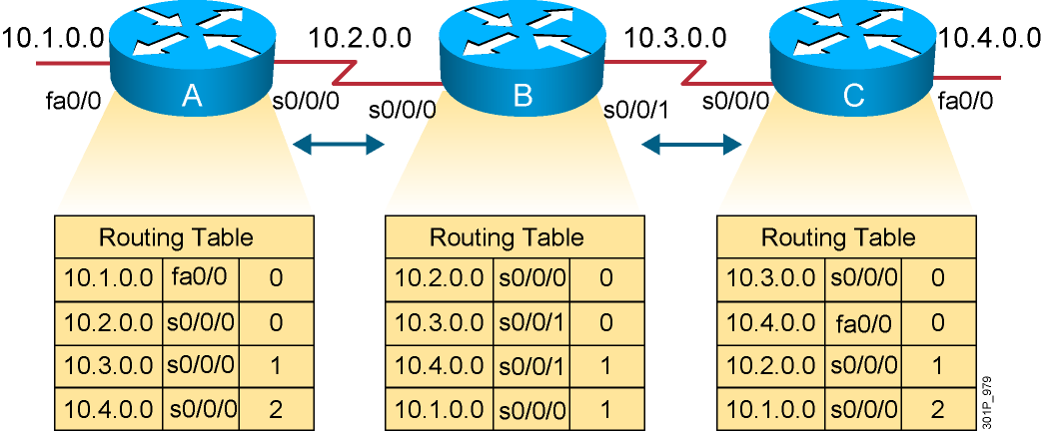
Sources of Information and Discovering Routes
Routers discover the best path to destinations from each neighbor.
Notes:
Layer 3 of 3
Emphasize: Layer 3 adds the final entries received some time later that have distances of 2 from routers A and C.

Slide 31
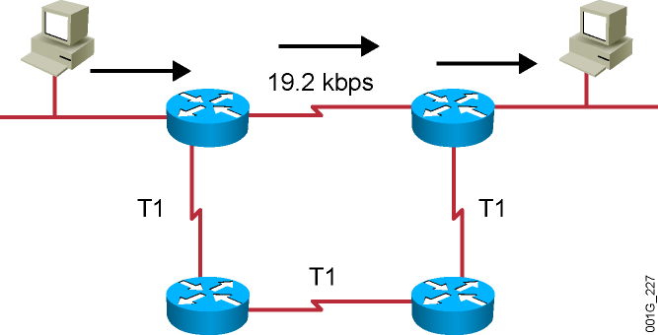
RIP Overview
Maximum is 16 equal-cost paths (default = 4)
Hop-count metric selects the path
Routes update every 30 seconds
Notes:
Purpose: This figure presents general information about RIP.
Emphasize: The figure shows a network. The arrows highlight the path RIP selects. RIP selects the best path based on the shortest hop count, so it ignores the path with the faster T1 links.
Be sure that you do not disparage RIP. It was developed in a homogeneous network. If everything is connected via a single media type, then bandwidth-based metrics reduce to hop count. In some cases, RIP is more appropriate than other protocols. It is extremely well tested.

Slide 32
RIPv1 and RIPv2 Comparison
 | RIPv1 | RIPv2
Routing protocol | Classful | Classless
Supports variable-length subnet mask? | No | Yes
Sends the subnet mask along with the routing update? | No | Yes
Addressing type | Broadcast | Multicast
Defined in … | RFC 1058 | RFCs 1721, 1722, and 2453
Supports manual route summarization? | No | Yes
Authentication support? | No | Yes
Notes:
Purpose: This figure presents general information about RIP.
Emphasize: The figure shows a network. The arrows highlight the path RIP selects. RIP selects the best path based on the shortest hop count, so it ignores the path with the faster T1 links.
Be sure that you do not disparage RIP. It was developed in a homogeneous network. If everything is connected via a single media type, then bandwidth-based metrics reduce to hop count. In some cases, RIP is more appropriate than other protocols. It is extremely well tested.

Slide 33
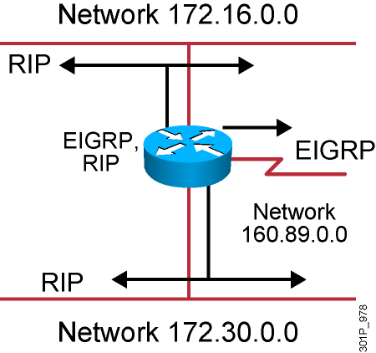
IP Routing Configuration Tasks
Router configuration
Select routing protocols
Specify networks or interfaces
Notes:
Purpose: This figure defines the tasks needed to configure IP routing.
Emphasize: This is a general overview of tasks, so the graphic shows both IGRP and RIP in the protocol box.
Tell your students that the router is able to route using both RIP and IGRP. It is possible to run IGRP and RIP concurrently. The IGRP information will override the RIP information by default because of IGRP’s administrative distance.
However, running IGRP and RIP concurrently does not work well when the network topology changes. Because IGRP and RIP have different update timers, and because they require different amounts of time to propagate routing updates, one part of the network may end up believing IGRP routes and another part may end up believing RIP routes. This will result in routing loops.
Review the fundamentals of router-configuration and interface-configuration modes.
Transition: The command to enable dynamic routing follows.

Slide 34
RIP Configuration
RouterX(config)# router rip
Starts the RIP routing process
RouterX(config-router)# version 2
Enables RIP version 2
RouterX(config-router)# network network-number
Selects participating attached networks
Requires a major classful network number
Notes:
Purpose: This figure presents the Cisco IOS™ commands used to configure RIP.
Emphasize: The figure shows the router rip command and the network network-number command. A proper understanding of these commands will save many problems in the lab.
Point out that the network statement contains no subnetting information.
Networks are directly connected and are specified as a Class A, B, or C network number.
Transition: An example of configuration follows.

Slide 35
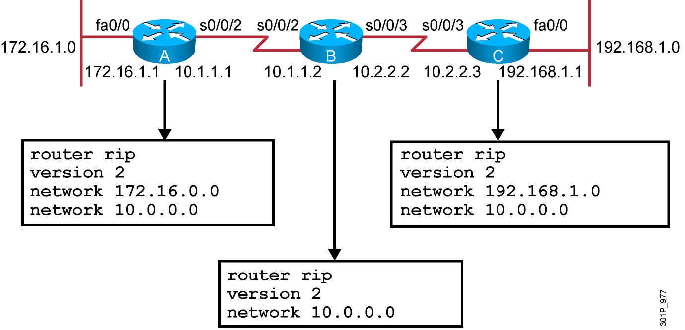
RIP Configuration Example
Notes:
Purpose: The figure shows how the RIP commands operate on the example network.
Emphasize: An administrator only specifies directly connected networks that should be published to other routers.
Without the network command, nothing is advertised. With a network command, the router will advertise every subnet within the Class A, B, or C network specified in the configuration.

Slide 36
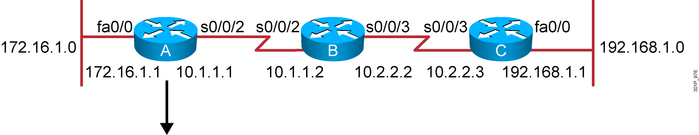
Verifying the RIP Configuration
Routing Protocol is "rip"
Sending updates every 30 seconds, next due in 6 seconds
Invalid after 180 seconds, hold down 180, flushed after 240
Outgoing update filter list for all interfaces is not set
Incoming update filter list for all interfaces is not set
Redistributing: rip
Default version control: send version 2, receive version 2
Interface Send Recv Triggered RIP Key-chain
FastEthernet0/0 2 2
Serial0/0/2 2 2
Automatic network summarization is in effect
Maximum path: 4
Routing for Networks:
10.0.0.0
172.16.0.0
Routing Information Sources:
Gateway Distance Last Update
10.1.1.2 120 00:00:25
Distance: (default is 120)
RouterA#
Notes:
Purpose: This figure shows how the show ip protocol command is used to monitor RIP operation.
Emphasize: The command displays the routing protocols that are active on the router for IP. It also gives network and timer information.
Point out the timing information.
Point out the list of networks for which the router is injecting routes.
Point out the administrative distance metric.

Slide 37
Displaying the IP Routing Table
RouterA# show ip route
Codes: C - connected, S - static, I - IGRP, R - RIP, M - mobile, B - BGP
D - EIGRP, EX - EIGRP external, O - OSPF, IA - OSPF inter area
N1 - OSPF NSSA external type 1, N2 - OSPF NSSA external type 2
E1 - OSPF external type 1, E2 - OSPF external type 2, E - EGP
i - IS-IS, L1 - IS-IS level-1, L2 - IS-IS level-2, * - candidate default
U - per-user static route, o - ODR
T - traffic engineered route
Gateway of last resort is not set
172.16.0.0/24 is subnetted, 1 subnets
C 172.16.1.0 is directly connected, fastethernet0/0
10.0.0.0/24 is subnetted, 2 subnets
R 10.2.2.0 [120/1] via 10.1.1.2, 00:00:07, Serial0/0/2
C 10.1.1.0 is directly connected, Serial0/0/2
R 192.168.1.0/24 [120/2] via 10.1.1.2, 00:00:07, Serial0/0/2
Notes:
Purpose: This figure displays the show ip route command, which displays the contents of the router’s IP routing table.
Emphasize: Discuss the IP routing table in detail. Show the locations of the hop count (metric) and the administrative distance (120).
Discuss the following fields:
R—Refers to routes learned from RIP.
via—Refers to the router that informed us about this route.
00:00:07 timer value—RIP updates are every 30 seconds. Ask, “How long until the next update?”
The interfaces used for the best path

Slide 38
debug ip rip Command
RouterA# debug ip rip
RIP protocol debugging is on
RouterA#
00:06:24: RIP: received v1 update from 10.1.1.2 on Serial0/0/2
00:06:24: 10.2.2.0 in 1 hops
00:06:24: 192.168.1.0 in 2 hops
00:06:33: RIP: sending v1 update to 255.255.255.255 via FastEthernet0/0 (172.16.1.1)
00:06:34: network 10.0.0.0, metric 1
00:06:34: network 192.168.1.0, metric 3
00:06:34: RIP: sending v1 update to 255.255.255.255 via Serial0/0/2 (10.1.1.1)
00:06:34: network 172.16.0.0, metric 1
Notes:
Purpose: This figure shows the debug ip rip command.
Emphasize: Explain that debug commands also provide information for monitoring IP.
The first highlighted line lists the source of the updates. The router returned information about two destinations.
The last highlighted line shows the broadcast address to which the router sent updates.

Slide 39
Summary
Routing is the process by which items get from one location to another.
Dynamic routing protocols determine how updates are conveyed, what knowledge is conveyed, when to convey knowledge, and how to locate recipients of the updates.
A routing protocol that has a lower administrative value is more trustworthy than a protocol that has a higher administrative value.
There are three classes of routing protocols: distance vector, link-state, and balanced hybrid.
The ip classless command can be used to prevent a router from dropping a packet that is destined for an unknown subnetwork of a directly attached network if a default route is configured.
Notes:
Purpose: This slide discuss the initial configurations on the routers and switches.
Note: There is no setup mode on the Catalyst 1900 switch.

Slide 40
Summary (Cont.)
RIP is a distance vector routing protocol that uses hop count as the matrix for route selection and broadcasts updates every 30 seconds.
RIPv1 uses classful routing protocol; RIPv2 uses classless routing protocol. RIPv2 supports VLSM, manual route summarization, and authentication; RIPv1 does not support these activities.
To enable a dynamic routing protocol, first a routing protocol is selected, then IP network numbers are assigned without values being specified (except OSPF).
The router command starts the routing process. The network command allows the routing process to determine which interfaces will participate in sending and receiving the routing updates.
Notes:
Purpose: This slide discuss the initial configurations on the routers and switches.
Note: There is no setup mode on the Catalyst 1900 switch.

Slide 41
Summary (Cont.)
The router RIP command selects RIP as the routing protocol. The network command identifies a participating attached network.
The show ip command displays information about routing protocols and the routing table.
The debug ip rip command displays information on RIP routing transactions.
Notes:
Purpose: This slide discuss the initial configurations on the routers and switches.
Note: There is no setup mode on the Catalyst 1900 switch.

Slide 42
Single-Area OSPF Implementation
Implementing OSPF

Slide 43
OSPF Overview
Creates a neighbor relationship by exchanging hello packets
Propagates LSAs rather than routing table updates
Link: Router interface
State: Description of an interface and its relationship to neighboring routers
Floods LSAs to all OSPF routers in the area, not just directly connected routers
Pieces together all the LSAs generated by the OSPF routers to create the OSPF link-state database
Uses the SPF algorithm to calculate the shortest path to each destination and places it in the routing table
Notes:
Purpose: This figure presents the IGRP metric with its five possible components.
Emphasize : Bandwidth and delay are the two metrics that are most commonly used. They also comprise the default metric.
Note: Changing IGRP metrics can have great impact on network performance.
Describe the IGRP 24-bit metric field, as follows:
Bandwidth—Minimum bandwidth on the route, in kilobits per second.
Delay—Route delay, in tens of microseconds.
Reliability—Likelihood of successful packet transmission, expressed as an integer from 0 to 255.
Loading—Effective bandwidth of path.
MTU—Minimum MTU in path, expressed in bytes.
The following equation calculates the metric. It is presented for instructors and is not required to be taught:
metric = [k1 x bandwidth + (k2 x bandwidth) / (256 - load) + k3 x delay]
If k5 does not equal 0, an additional operation is done:
metric = metric x (k5/(reliability + k4))
The default constant values are k1 = k3 = 1 and k2 = k4 = k5 = 0.
Again, if default values are set, metric = bandwidth + delay.
The constants (k1, k2, k3) can be changed using the metric weights command. Changes to the IGRP constant values should be made with great care.

Slide 44
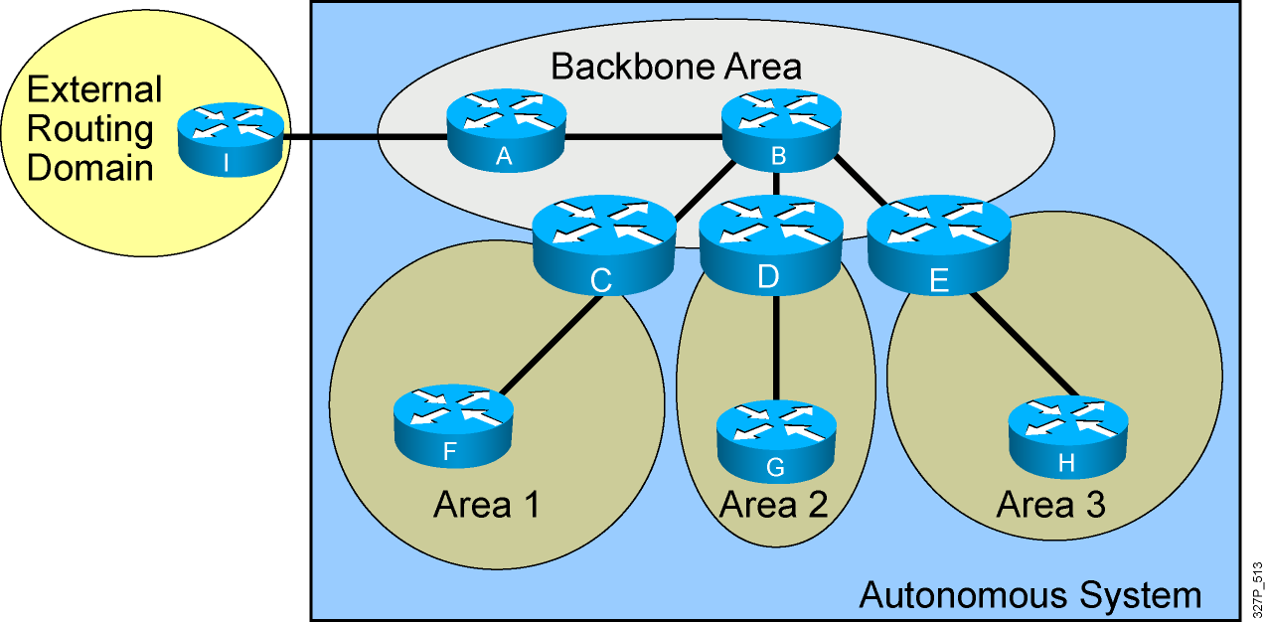
OSPF Hierarchy Example
Minimizes routing table entries
Localizes the impact of a topology change within an area
Notes:
Summarizing is the consolidation of multiple routes into one single advertisement. Proper summarization requires contiguous addressing.
Route summarization directly affects the amount of bandwidth, CPU, and memory resources consumed by the OSPF process. With summarization, if a network link fails, the topology change will not be propagated into the backbone (and other areas by way of the backbone). As such, flooding outside the area will not occur, so routers outside of the area with the topology change will not have to run the SPF algorithm (also called the Dijkstra algorithm after the computer scientist who invented it). Running the SPF algorithm is a CPU-intensive activity.
There are two types of summarization:
Interarea route summarization—Interarea route summarization is done on ABRs and applies to routes from within the autonomous system. It does not apply to external routes injected into OSPF via redistribution. In order to take advantage of summarization, network numbers in areas should be assigned in a contiguous way so as to be able to consolidate these addresses into one range. This graphic illustrates interarea summarization.
External route summarization—External route summarization is specific to external routes that are injected into OSPF via redistribution. Here again, it is important to ensure that external address ranges that are being summarized are contiguous. Summarization overlapping ranges from two different routers could cause packets to be sent to the wrong destination.

Slide 45
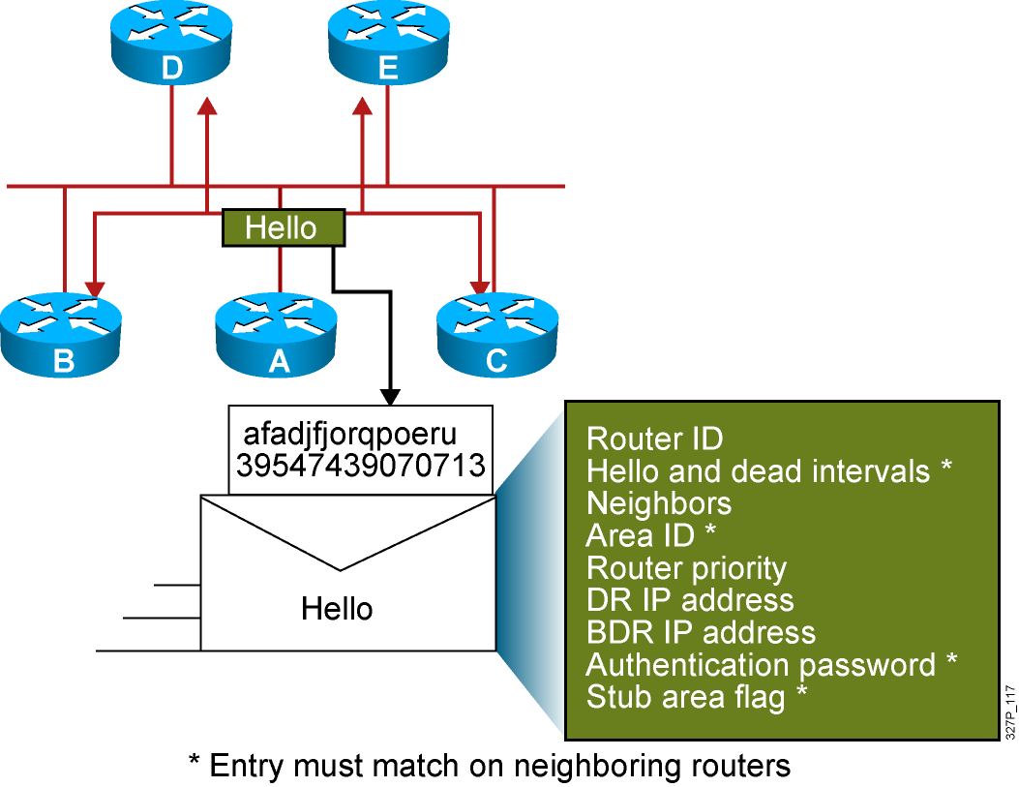
Neighbor Adjacencies: The Hello Packet

Slide 46
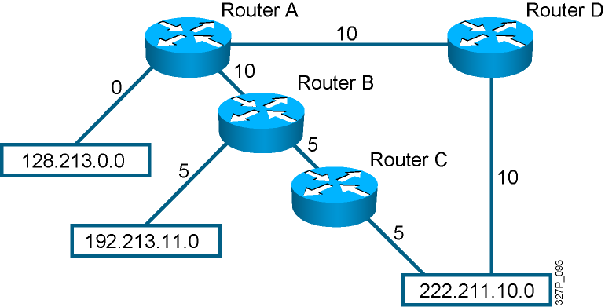
SPF Algorithm
10
10
1
1
1
Places each router at the root of a tree and calculates the shortest path to each destination based on the cumulative cost
Cost = Reference Bandwidth / Interface Bandwidth (b/s)
Notes:
Purpose: The figure presents how IGRP load sharing improves throughput and increases reliability.
Emphasize: Only feasible paths can be used for IGRP load sharing.
Load-balancing methods vary according to the switching mode because the data structures for process switching, fast switching, and autonomous switching are all different. When process switching, the processor load-balances packet by packet. When fast, autonomous, or silicon switching, load balancing is done destination by destination.
By default, the amount of variance is set to one, which results in equal-cost load balancing.
You can use the default-metric command to change the default metric.
Transition: The following pages describe how to configure the IGRP routing protocol.

Slide 47
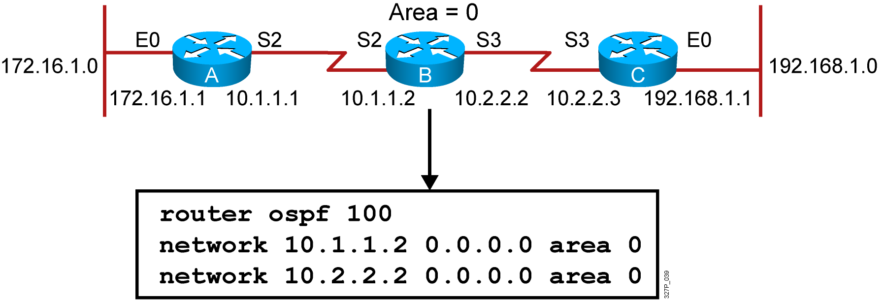
Configuring Single-Area OSPF
RouterX(config)#
router ospf process-id
Defines OSPF as the IP routing protocol
RouterX(config-router)#
network address wildcard-mask area area-id
Assigns networks to a specific OSPF area
Notes:
Slide 1 of 2
Purpose: This figure explains how to use the router igrp and network commands to configure an IGRP process.
Emphasize: Note that the AS keyword is required for IGRP.
You can use multiple network commands to specify all networks that are to participate in the IGRP process. Only those networks specified will be published to other routers.

Slide 48
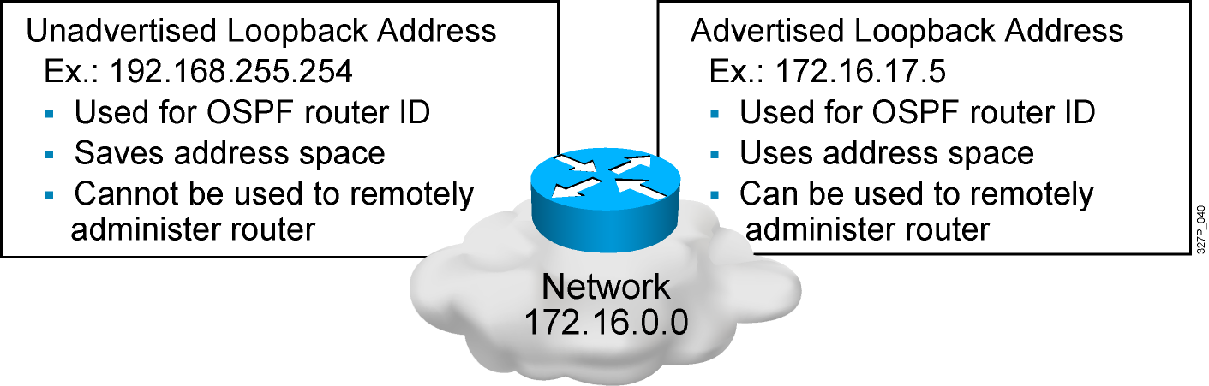
Configuring Loopback Interfaces
Router ID:
Number by which the router is known to OSPF
Default: The highest IP address on an active interface at the moment of OSPF process startup
Can be overridden by a loopback interface: Highest IP address of any active loopback interface
Can be set manually using the router-id command

Slide 49
Verifying the OSPF Configuration
RouterX# show ip protocols
Verifies that OSPF is configured
RouterX# show ip route
Displays all the routes learned by the router
RouterX# show ip route
Codes: I - IGRP derived, R - RIP derived, O - OSPF derived,
C - connected, S - static, E - EGP derived, B - BGP derived,
E2 - OSPF external type 2 route, N1 - OSPF NSSA external type 1 route,
N2 - OSPF NSSA external type 2 route
Gateway of last resort is 10.119.254.240 to network 10.140.0.0
O 10.110.0.0 [110/5] via 10.119.254.6, 0:01:00, Ethernet2
O IA 10.67.10.0 [110/10] via 10.119.254.244, 0:02:22, Ethernet2
O 10.68.132.0 [110/5] via 10.119.254.6, 0:00:59, Ethernet2
O 10.130.0.0 [110/5] via 10.119.254.6, 0:00:59, Ethernet2
O E2 10.128.0.0 [170/10] via 10.119.254.244, 0:02:22, Ethernet2
. . .
Notes:
240, 197, 102

Slide 50
Verifying the OSPF Configuration (Cont.)
RouterX# show ip ospf
Displays the OSPF router ID, timers, and statistics
RouterX# show ip ospf
Routing Process "ospf 50" with ID 10.64.0.2
<output omitted>
Number of areas in this router is 1. 1 normal 0 stub 0 nssa
Number of areas transit capable is 0
External flood list length 0
Area BACKBONE(0)
Area BACKBONE(0)
Area has no authentication
SPF algorithm last executed 00:01:25.028 ago
SPF algorithm executed 7 times
<output omitted>

Slide 51
Verifying the OSPF Configuration (Cont.)
RouterX# show ip ospf interface
Displays the area ID and adjacency information
RouterX# show ip ospf interface ethernet 0
Ethernet 0 is up, line protocol is up
Internet Address 192.168.254.202, Mask 255.255.255.0, Area 0.0.0.0
AS 201, Router ID 192.168.99.1, Network Type BROADCAST, Cost: 10
Transmit Delay is 1 sec, State OTHER, Priority 1
Designated Router id 192.168.254.10, Interface address 192.168.254.10
Backup Designated router id 192.168.254.28, Interface addr 192.168.254.28
Timer intervals configured, Hello 10, Dead 60, Wait 40, Retransmit 5
Hello due in 0:00:05
Neighbor Count is 8, Adjacent neighbor count is 2
Adjacent with neighbor 192.168.254.28 (Backup Designated Router)
Adjacent with neighbor 192.168.254.10 (Designated Router)

Slide 52
Verifying the OSPF Configuration (Cont.)
RouterX# show ip ospf neighbor
Displays the OSPF neighbor information on a per-interface basis
RouterX# show ip ospf neighbor
ID Pri State Dead Time Address Interface
10.199.199.137 1 FULL/DR 0:00:31 192.168.80.37 FastEthernet0/0
172.16.48.1 1 FULL/DROTHER 0:00:33 172.16.48.1 FastEthernet0/1
172.16.48.200 1 FULL/DROTHER 0:00:33 172.16.48.200 FastEthernet0/1
10.199.199.137 5 FULL/DR 0:00:33 172.16.48.189 FastEthernet0/1

Slide 53
Verifying the OSPF Configuration (Cont.)
RouterX# show ip ospf neighbor 10.199.199.137
Neighbor 10.199.199.137, interface address 192.168.80.37
In the area 0.0.0.0 via interface Ethernet0
Neighbor priority is 1, State is FULL
Options 2
Dead timer due in 0:00:32
Link State retransmission due in 0:00:04
Neighbor 10.199.199.137, interface address 172.16.48.189
In the area 0.0.0.0 via interface Fddi0
Neighbor priority is 5, State is FULL
Options 2
Dead timer due in 0:00:32
Link State retransmission due in 0:00:03

Slide 54
OSPF debug Commands
RouterX# debug ip ospf events
OSPF:hello with invalid timers on interface Ethernet0
hello interval received 10 configured 10
net mask received 255.255.255.0 configured 255.255.255.0
dead interval received 40 configured 30
OSPF: rcv. v:2 t:1 l:48 rid:200.0.0.117
aid:0.0.0.0 chk:6AB2 aut:0 auk:
RouterX# debug ip ospf packet
OSPF: rcv. v:2 t:1 l:48 rid:200.0.0.116
aid:0.0.0.0 chk:0 aut:2 keyid:1 seq:0x0

Slide 55
Load Balancing with OSPF
OSPF load balancing:
Paths must be equal cost
By default, up to four equal-cost paths can be placed into the routing table
With a configuration change, up to a maximum of 16 paths can be configured:
(config-router)# maximum-paths <value>
To ensure paths are equal cost for load balancing, you can change the cost of a particular link:
(config-if)# ip ospf cost <value>

Slide 56
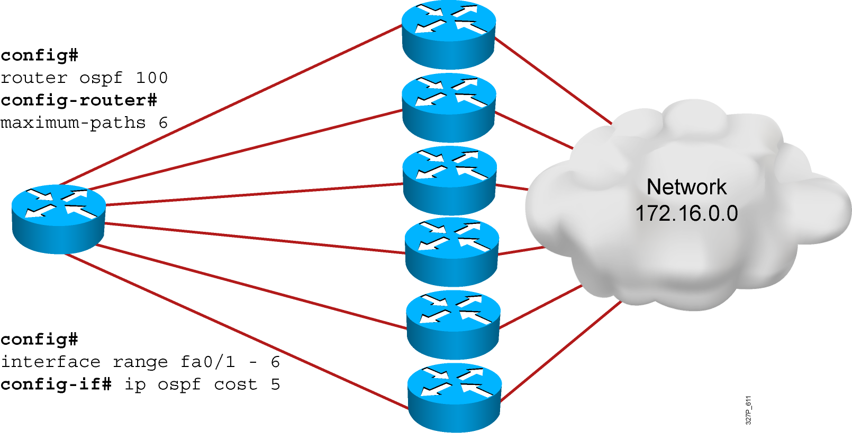
Load Balancing with OSPF

Slide 57
OSPF Authentication
OSPF supports two types of authentication:
Plaintext (or simple) password authentication
MD5 authentication
The router generates and checks every OSPF packet.
The router authenticates the source of each routing update packet that it receives.
Configure a “key” (password); each participating neighbor must have the same key configured.

Slide 58
Configuring OSPF Plaintext Password Authentication
RouterX(config-if)#
ip ospf authentication-key password
Assigns a password to use with neighboring routers
RouterX(config-if)#
ip ospf authentication [message-digest | null]
Specifies the authentication type for an interface (as of Cisco IOS Release 12.0)
OR
RouterX(config-router)#
area area-id authentication [message-digest]
Specifies the authentication type for an area

Slide 59
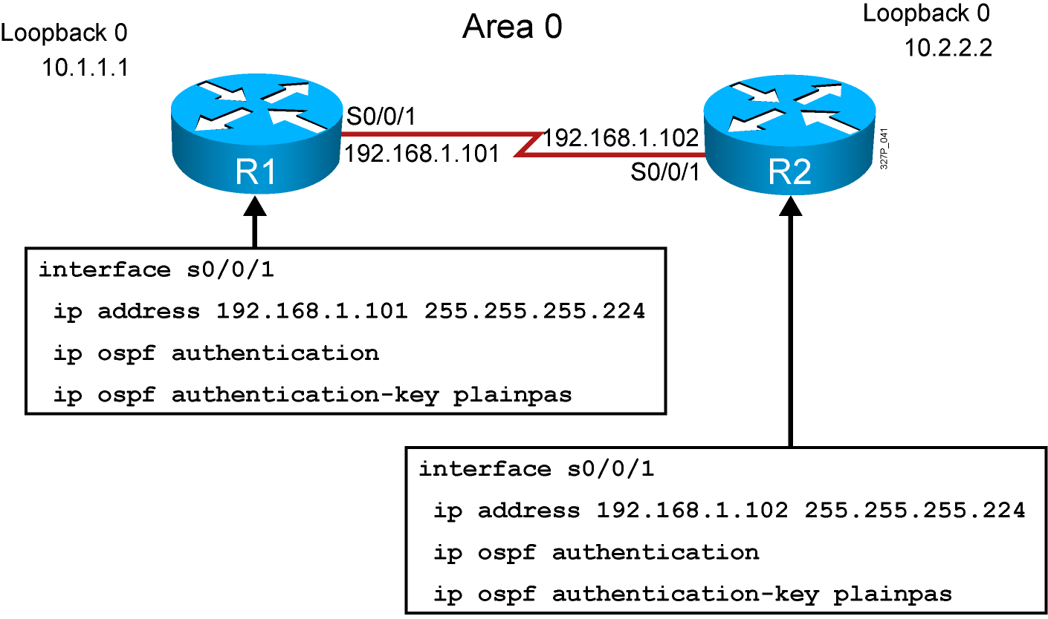
Plaintext Password Authentication Configuration Example

Slide 60
Verifying Plaintext Password Authentication
RouterX#show ip ospf neighbor
Neighbor ID Pri State Dead Time Address Interface
10.2.2.2 0 FULL/ - 00:00:32 192.168.1.102 Serial0/0/1
RouterX#show ip route
<output omitted>
Gateway of last resort is not set
10.0.0.0/8 is variably subnetted, 2 subnets, 2 masks
O 10.2.2.2/32 [110/782] via 192.168.1.102, 00:01:17, Serial0/0/1
C 10.1.1.0/24 is directly connected, Loopback0
192.168.1.0/27 is subnetted, 1 subnets
C 192.168.1.96 is directly connected, Serial0/0/1
RouterX#ping 10.2.2.2
Type escape sequence to abort.
Sending 5, 100-byte ICMP Echos to 10.2.2.2, timeout is 2 seconds:
!!!!!
Success rate is 100 percent (5/5), round-trip min/avg/max = 28/29/32 ms

Slide 61
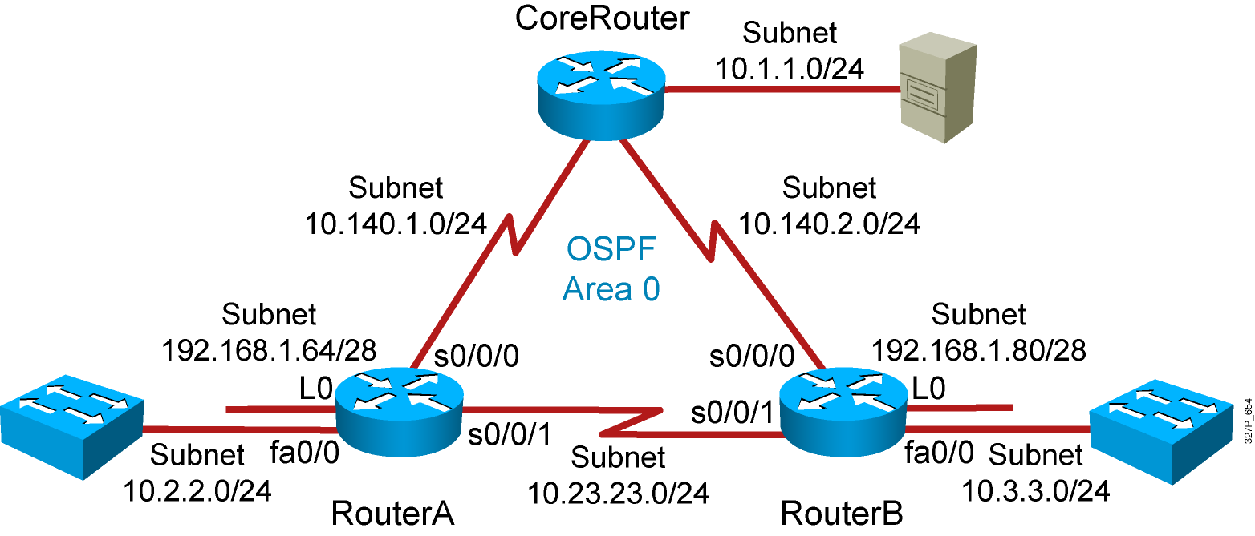
Visual Objective 4-1: Implementing OSPF
Notes:
Lab 10 amended pod b and pod I addresses move core_ro address closer to interface same with s0 pod L
Objectives: Enable the IGRP dynamic routing protocol so your router can learn about nonconnected networks.
Purpose: Teach students how to enable IGRP.
Laboratory Instructions: Refer to the lab setup guide.

Slide 62
Summary
OSPF is a classless, link-state routing protocol that uses an area hierarchy for fast convergence.
OSPF exchanges hello packets to establish neighbor adjacencies between routers.
The SPF algorithm uses a cost metric to determine the best path. Lower costs indicate a better path.
The router ospf process-id command is used to enable OSPF on the router.
Use a loopback interface to keep the OSPF router ID consistent.
The show ip ospf neighbor command displays OSPF neighbor information on a per-interface basis.
The commands debug ip ospf events and debug ip ospf packets can be used to troubleshoot OSPF problems.
OSPF will load-balance across up to four equal-cost metric paths by default.
There are two types of OSPF authentication: Plaintext and MD5.

Slide 63
EIGRP Implementation
Implementing EIGRP

Slide 64
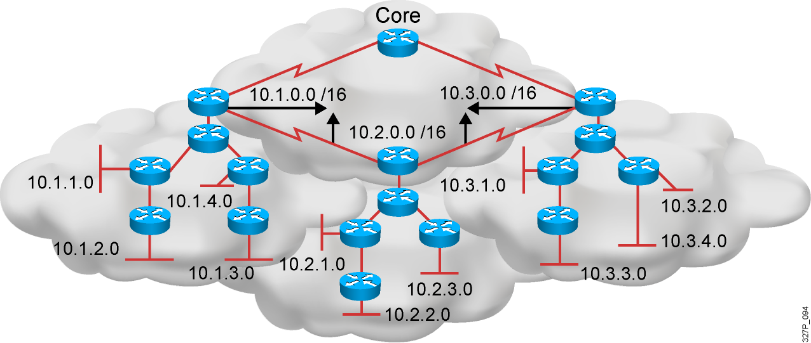
EIGRP Features
Advanced distance vector
Rapid convergence
100% loop-free classless routing
Easy configuration
Incremental updates
Load balancing across equal- and unequal-cost pathways
Flexible network design
Multicast and unicast instead of broadcast address
Support for VLSM and discontiguous subnets
Manual summarization at any point in the internetwork
Support for multiple network layer protocols

Slide 65
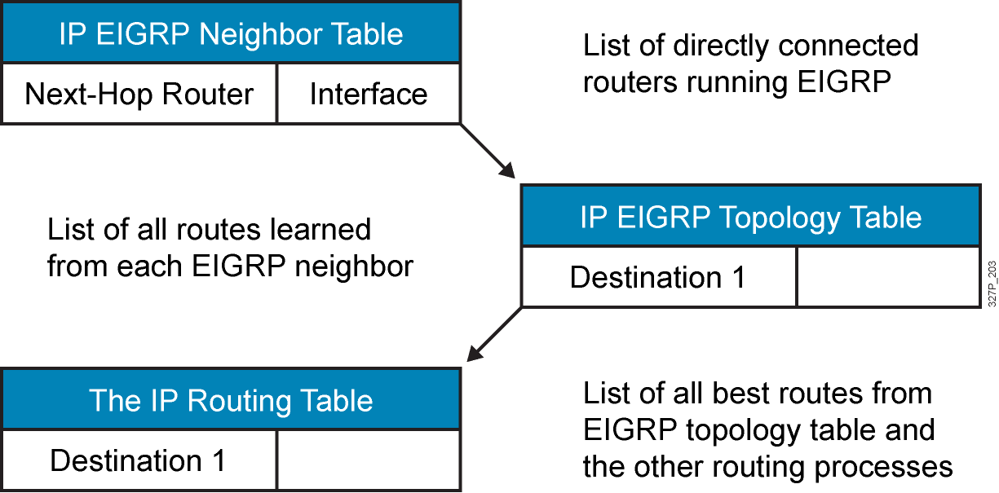
EIGRP Tables

Slide 66
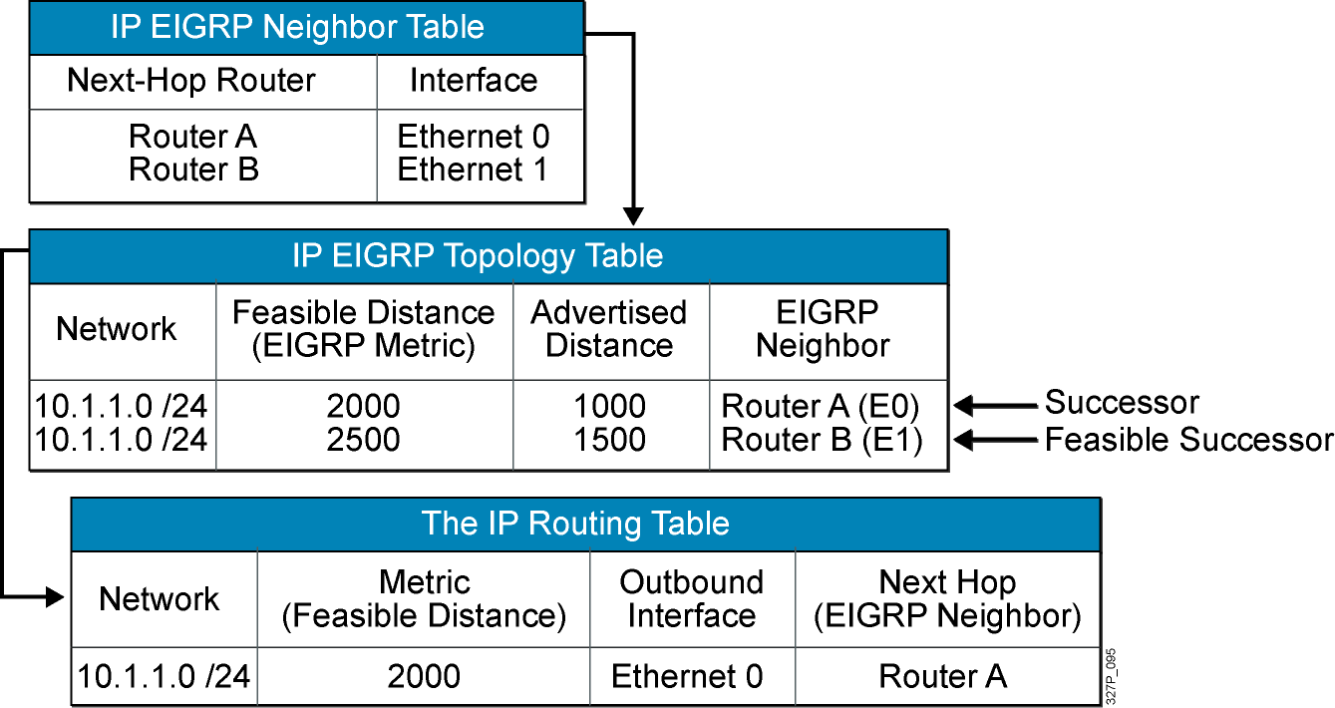
EIGRP Path Calculation (Router C)

Slide 67
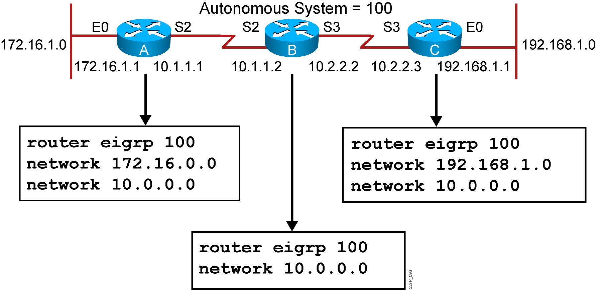
EIGRP Configuration
RouterX(config)# router eigrp autonomous-system
RouterX(config-router)# network network-number
Notes:
Purpose: The figure shows how the IGRP commands operate on the example network.
Emphasize: An administrator only specifies directly connected networks that should be published to other routers.
Without the network command, nothing is advertised. With a network command, the router will advertise every subnet within the Class A, B, or C network specified in the configuration.

Slide 68
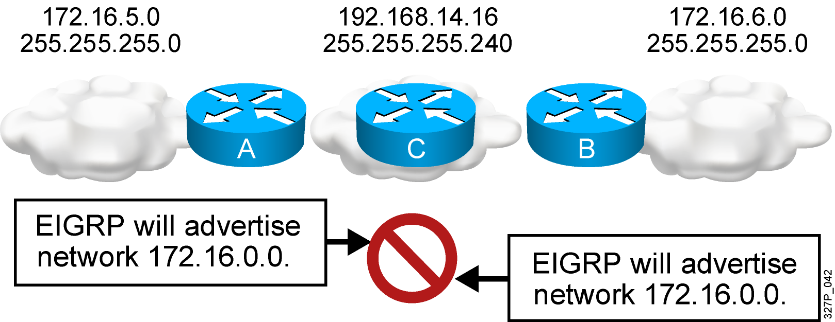
EIGRP and Discontiguous Networks Default Scenario Configuration
EIGRP, by default, does not advertise subnets and, therefore, cannot support discontiguous subnets.

Slide 69
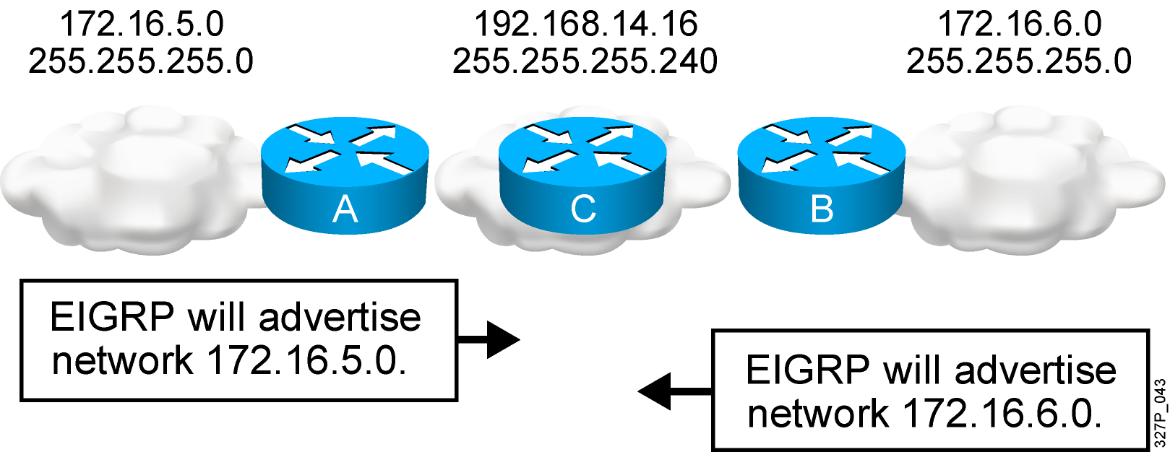
EIGRP and Discontiguous Networks with no auto-summary
EIGRP with the no auto-summary parameter can advertise subnets and, therefore, can support discontiguous subnets.

Slide 70
Verifying the EIGRP Configuration
RouterX# show ip route eigrp
Displays the current EIGRP entries in the routing table
RouterX# show ip protocols
Displays the parameters and current state of the active process
RouterX# show ip eigrp interfaces
Displays information about interfaces configured for EIGRP
RouterX# show ip eigrp interfaces
IP EIGRP interfaces for process 109
Xmit Queue Mean Pacing Time Multicast Pending
Interface Peers Un/Reliable SRTT Un/Reliable Flow Timer Routes
Di0 0 0/0 0 11/434 0 0
Et0 1 0/0 337 0/10 0 0
SE0:1.16 1 0/0 10 1/63 103 0
Tu0 1 0/0 330 0/16 0 0
Notes:
Purpose: This figure shows how the show ip protocol command is used to monitor IGRP operation.
Emphasize: The command displays the routing protocols that are active on the router for IP. It also gives network and timer information. In this example, IGRP is displayed.
Point out the timing information.
Point out the list of networks for which the router is injecting routes.
Point out the administrative distance metric.

Slide 71
Verifying the EIGRP Configuration (Cont.)
RouterX# show ip eigrp neighbors [detail]
Displays the neighbors discovered by IP EIGRP
RouterX# show ip eigrp neighbors
IP-EIGRP Neighbors for process 77
Address Interface Holdtime Uptime Q Seq SRTT RTO
(secs) (h:m:s) Count Num (ms) (ms)
172.16.81.28 Ethernet1 13 0:00:41 0 11 4 20
172.16.80.28 Ethernet0 14 0:02:01 0 10 12 24
172.16.80.31 Ethernet0 12 0:02:02 0 4 5 20
Notes:
Purpose: This figure shows how the show ip protocol command is used to monitor IGRP operation.
Emphasize: The command displays the routing protocols that are active on the router for IP. It also gives network and timer information. In this example, IGRP is displayed.
Point out the timing information.
Point out the list of networks for which the router is injecting routes.
Point out the administrative distance metric.

Slide 72
Verifying the EIGRP Configuration (Cont.)
RouterX# show ip eigrp topology [all]
Displays the IP EIGRP topology table
Without the [all] parameter, shows successors and feasible successors
RouterX# show ip eigrp topology
IP-EIGRP Topology Table for process 77
Codes: P - Passive, A - Active, U - Update, Q - Query, R - Reply,
r - Reply status
P 172.16.90.0 255.255.255.0, 2 successors, FD is 46251776
via 172.16.80.28 (46251776/46226176), Ethernet0
via 172.16.81.28 (46251776/46226176), Ethernet1
via 172.16.80.31 (46277376/46251776), Serial0
P 172.16.81.0 255.255.255.0, 2 successors, FD is 307200
via Connected, Ethernet1
via 172.16.81.28 (307200/281600), Ethernet1
via 172.16.80.28 (307200/281600), Ethernet0
via 172.16.80.31 (332800/307200), Serial0
Notes:
240, 197, 102

Slide 73
Verifying the EIGRP Configuration (Cont.)
RouterX# show ip eigrp traffic
Displays the number of IP EIGRP packets sent and received
RouterX# show ip eigrp traffic
IP-EIGRP Traffic Statistics for process 77
Hellos sent/received: 218/205
Updates sent/received: 7/23
Queries sent/received: 2/0
Replies sent/received: 0/2
Acks sent/received: 21/14
Notes:
Purpose: This figure shows how the show ip protocol command is used to monitor IGRP operation.
Emphasize: The command displays the routing protocols that are active on the router for IP. It also gives network and timer information. In this example, IGRP is displayed.
Point out the timing information.
Point out the list of networks for which the router is injecting routes.
Point out the administrative distance metric.

Slide 74
debug ip eigrp Command
RouterX# debug ip eigrp
IP-EIGRP: Processing incoming UPDATE packet
IP-EIGRP: Ext 192.168.3.0 255.255.255.0 M 386560 - 256000 130560 SM 360960 – 256000 104960
IP-EIGRP: Ext 192.168.0.0 255.255.255.0 M 386560 - 256000 130560 SM 360960 – 256000 104960
IP-EIGRP: Ext 192.168.3.0 255.255.255.0 M 386560 - 256000 130560 SM 360960 – 256000 104960
IP-EIGRP: 172.69.43.0 255.255.255.0, - do advertise out Ethernet0/1
IP-EIGRP: Ext 172.69.43.0 255.255.255.0 metric 371200 - 256000 115200
IP-EIGRP: 192.135.246.0 255.255.255.0, - do advertise out Ethernet0/1
IP-EIGRP: Ext 192.135.246.0 255.255.255.0 metric 46310656 - 45714176 596480
IP-EIGRP: 172.69.40.0 255.255.255.0, - do advertise out Ethernet0/1
IP-EIGRP: Ext 172.69.40.0 255.255.255.0 metric 2272256 - 1657856 614400
IP-EIGRP: 192.135.245.0 255.255.255.0, - do advertise out Ethernet0/1
IP-EIGRP: Ext 192.135.245.0 255.255.255.0 metric 40622080 - 40000000 622080
IP-EIGRP: 192.135.244.0 255.255.255.0, - do advertise out Ethernet0/1
Note: EIGRP routes are exchanged only when a change in topology occurs.

Slide 75
EIGRP Metric
The criteria that EIGRP uses by default to calculate its metric:
Bandwidth
Delay
The optional criteria that EIGRP can be configured to use when calculating its metric:
Reliability
Load
Note: Although MTU is exchanged in EIGRP packets between neighbor routers, MTU is not factored into the EIGRP metric calculation.

Slide 76
EIGRP Load Balancing
By default, EIGRP does equal-metric load balancing:
By default, up to four routes with a metric equal to the minimum metric are installed in the routing table.
There can be up to 16 entries in the routing table for the same destination:
The number of entries is configurable with the maximum-paths command.

Slide 77
EIGRP Unequal-Cost Load Balancing
RouterX(config-router)#
variance multiplier
Allows the router to load-balance across routes with a metric smaller than the multiplier value times the minimum metric route to that destination.
The default variance is 1, which means equal-cost load balancing.

Slide 78
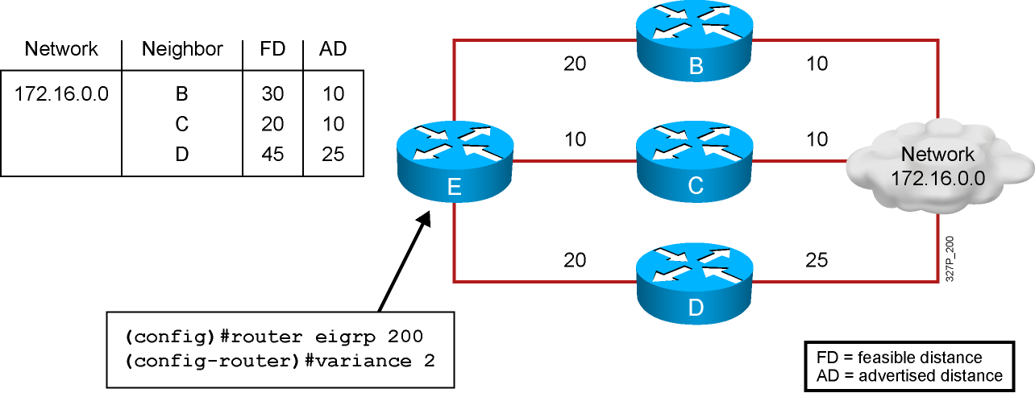
Variance Example
Router E chooses router C to route to network 172.16.0.0 because it has the lowest feasible distance of 20.
With a variance of 2, router E also chooses router B to route to network 172.16.0.0 (20 + 10 = 30) < [2 * (FD) = 40].
Router D is not considered to route to network 172.16.0.0 (because 25 > 20).

Slide 79
EIGRP MD5 Authentication
EIGRP supports MD5 authentication.
The router identifies itself for every EIGRP packet it sends.
The router authenticates the source of each routing update packet that it receives.
Each participating neighbor must have the same key configured.

Slide 80
EIGRP MD5 Authentication Configuration Steps
Create the keychain, a group of possible keys (passwords).
Assign a key ID to each key.
Identify the keys.
(Optional) Specify the duration a key will be valid.
Enable MD5 authentication on the interface.
Specify which keychain the interface will use.

Slide 81
Configuring EIGRP MD5 Authentication
RouterX(config)#
key chain name-of-chain
Enters the configuration mode for the keychain
RouterX(config-keychain)#
key key-id
Identifies the key and enters the configuration mode for the key ID

Slide 82
Configuring EIGRP MD5 Authentication (Cont.)
RouterX(config-keychain-key)#
key-string text
Identifies the key string (password)
RouterX(config-keychain-key)#
accept-lifetime start-time {infinite | end-time | duration seconds}
(Optional) Specifies when the key is accepted for received packets
RouterX(config-keychain-key)#
send-lifetime start-time {infinite | end-time | duration seconds}
(Optional) Specifies when the key can be used for sending packets

Slide 83
Configuring EIGRP MD5 Authentication (Cont.)
RouterX(config-if)#
ip authentication mode eigrp autonomous-system md5
Specifies MD5 authentication for EIGRP packets
RouterX(config-if)#
ip authentication key-chain eigrp autonomous-system
name-of-chain
Enables authentication of EIGRP packets using the key in the keychain

Slide 84
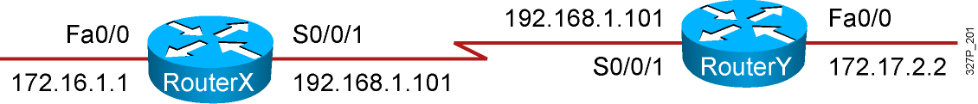
Example EIGRP MD5 Authentication Configuration
RouterX
<output omitted>
key chain RouterXchain
key 1
key-string firstkey
accept-lifetime 04:00:00 Jan 1 2006 infinite
send-lifetime 04:00:00 Jan 1 2006 04:01:00 Jan 1 2006
key 2
key-string secondkey
accept-lifetime 04:00:00 Jan 1 2006 infinite
send-lifetime 04:00:00 Jan 1 2006 infinite
<output omitted>
!
interface Serial0/0/1
bandwidth 64
ip address 192.168.1.101 255.255.255.224
ip authentication mode eigrp 100 md5
ip authentication key-chain eigrp 100 RouterXchain

Slide 85
Example EIGRP MD5 Authentication Configuration (Cont.)
RouterY
<output omitted>
key chain RouterYchain
key 1
key-string firstkey
accept-lifetime 04:00:00 Jan 1 2006 infinite
send-lifetime 04:00:00 Jan 1 2006 infinite
key 2
key-string secondkey
accept-lifetime 04:00:00 Jan 1 2006 infinite
send-lifetime 04:00:00 Jan 1 2006 infinite
<output omitted>
!
interface Serial0/0/1
bandwidth 64
ip address 192.168.1.102 255.255.255.224
ip authentication mode eigrp 100 md5
ip authentication key-chain eigrp 100 RouterYchain

Slide 86
Verifying MD5 Authentication
RouterX#
*Jan 21 16:23:30.517: %DUAL-5-NBRCHANGE: IP-EIGRP(0) 100: Neighbor 192.168.1.102 (Serial0/0/1) is up: new adjacency
RouterX#show ip eigrp neighbors
IP-EIGRP neighbors for process 100
H Address Interface Hold Uptime SRTT RTO Q Seq
(sec) (ms) Cnt Num
0 192.168.1.102 Se0/0/1 12 00:03:10 17 2280 0 14
RouterX#show ip route
<output omitted>
Gateway of last resort is not set
D 172.17.0.0/16 [90/40514560] via 192.168.1.102, 00:02:22, Serial0/0/1
172.16.0.0/16 is variably subnetted, 2 subnets, 2 masks
D 172.16.0.0/16 is a summary, 00:31:31, Null0
C 172.16.1.0/24 is directly connected, FastEthernet0/0
192.168.1.0/24 is variably subnetted, 2 subnets, 2 masks
C 192.168.1.96/27 is directly connected, Serial0/0/1
D 192.168.1.0/24 is a summary, 00:31:31, Null0
RouterX#ping 172.17.2.2
Type escape sequence to abort.
Sending 5, 100-byte ICMP Echos to 172.17.2.2, timeout is 2 seconds:
!!!!!
Success rate is 100 percent (5/5), round-trip min/avg/max = 12/15/16 ms

Slide 87
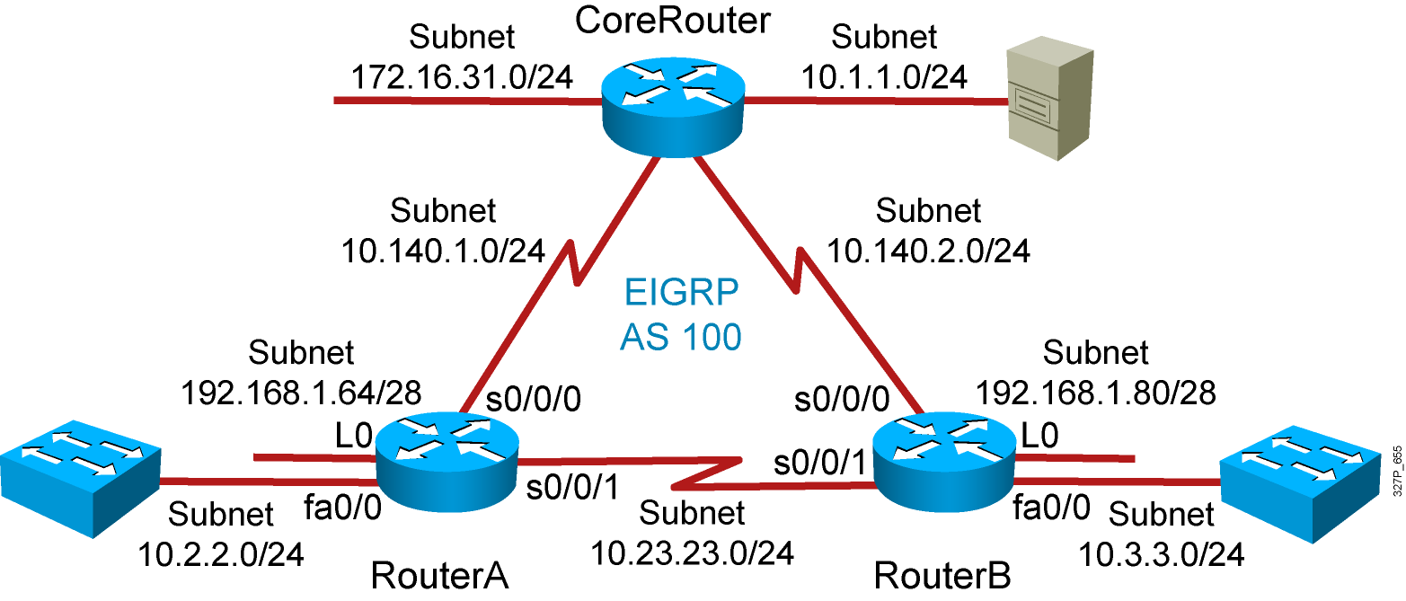
Visual Objective 5-1: Implementing EIGRP
Notes:
Lab 10 amended pod b and pod I addresses move core_ro address closer to interface same with s0 pod L
Objectives: Enable the IGRP dynamic routing protocol so your router can learn about nonconnected networks.
Purpose: Teach students how to enable IGRP.
Laboratory Instructions: Refer to the lab setup guide.

Slide 88
Summary
EIGRP is a classless, advanced distance vector routing protocol that runs the DUAL algorithm.
EIGRP requires you to configure an autonomous system number that must match on all routers to exchange routes.
EIGRP is capable of load balancing across unequal-cost paths.
EIGRP supports MD5 authentication to protect against unauthorized, rogue routers entering your network.

